Slide 1
Another perspective on a “well behaved” system.
Input-Output
Input-State
Lyapunov analysis
included feedback systems (with a specific feedback function)

Slide 2
u

Slide 3
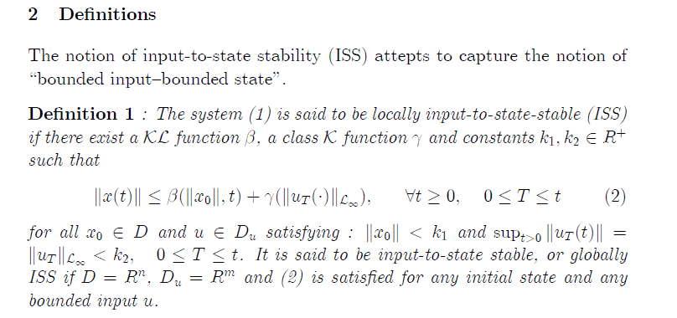
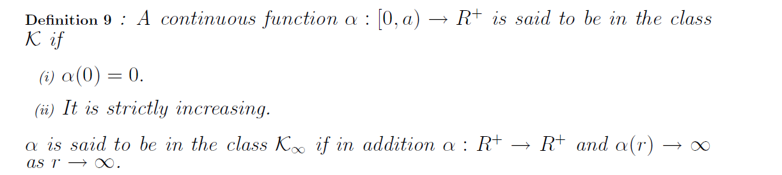
attempts
i.e., for any bounded input u(t) the state x(t) will be bounded.
Zero input
response
Bound on nonzero input response
Bound on IC
Bound on input
Reminder:
(chpt. 6)
Reminder:
(chpt. 3)
r
s

Slide 4
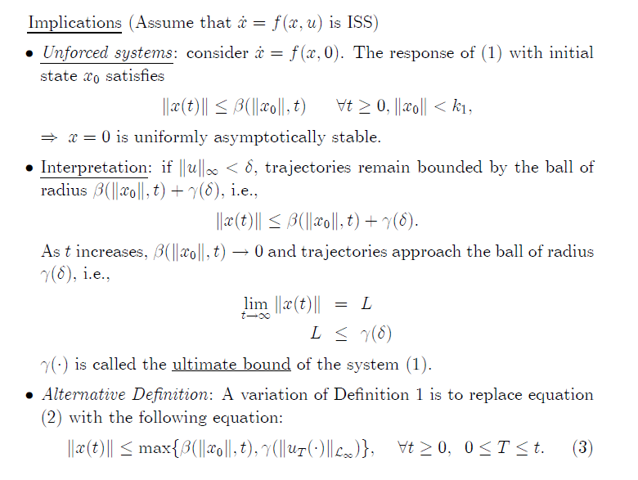
Theorem in Chapter 3
By
property

Slide 5
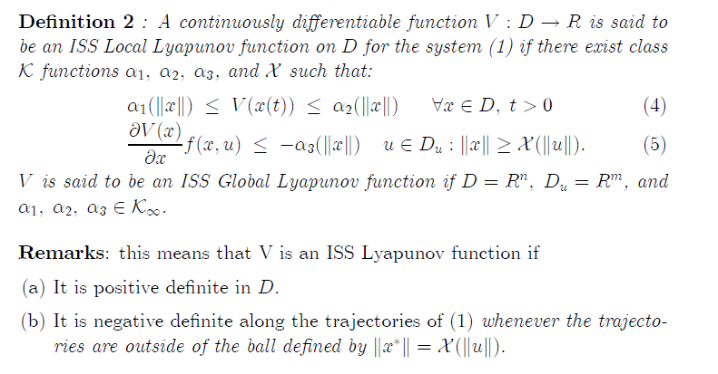
System:
V is PD
Sufficient condition for ISS.

Slide 6
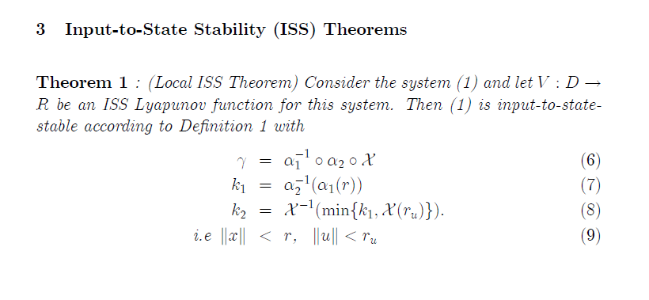
System:

Slide 8
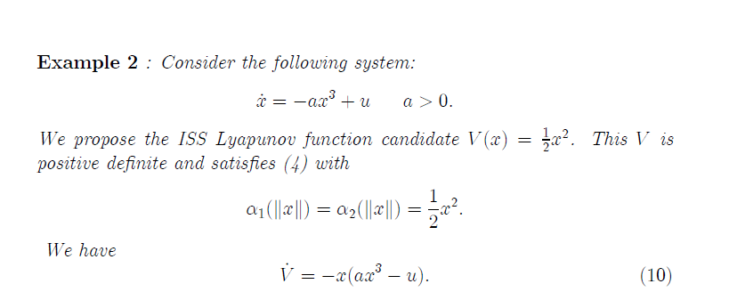
System:

Slide 9
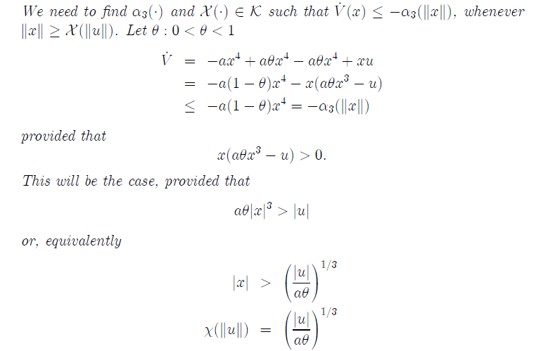
=0

Slide 11
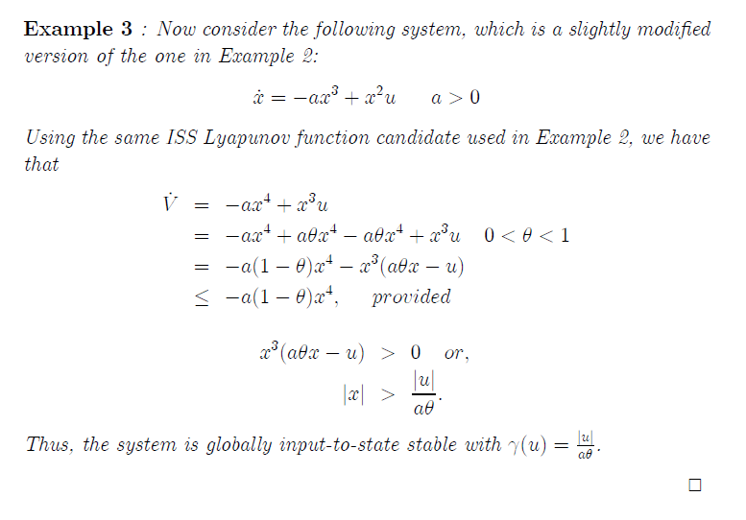

Slide 12
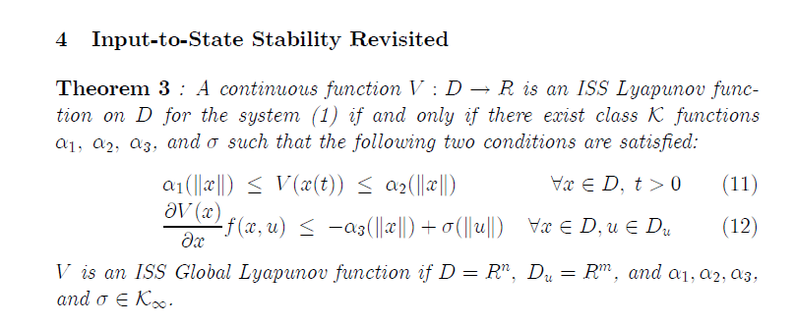

Slide 13
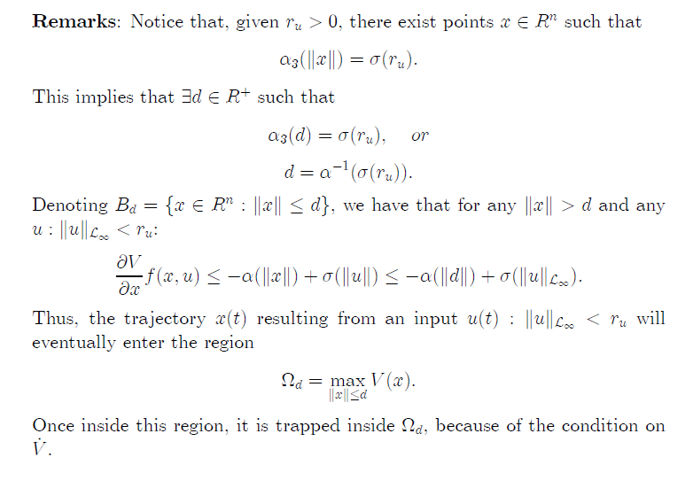

Slide 15
Summary
Input-Output
Input-State
Lyapunov
ISS -> for any bounded input u(t) the state x(t) will be bounded
Note that in previous Lyapunov analysis we had a specific u (feedback systems)
Can use a Lyapunov function to determine input to state stability (ISS).
Systems tool in that we know about the stability of cascaded systems

Slide 16
HW 7-1
Problems 7.1, 7.5, 7.6

Slide 17
HW 7-1-1(sol)
Approach:
V is PD

Slide 18
HW 7-1-1(sol)
V is PD

Slide 19
HW 7-1-1(sol)

Slide 20
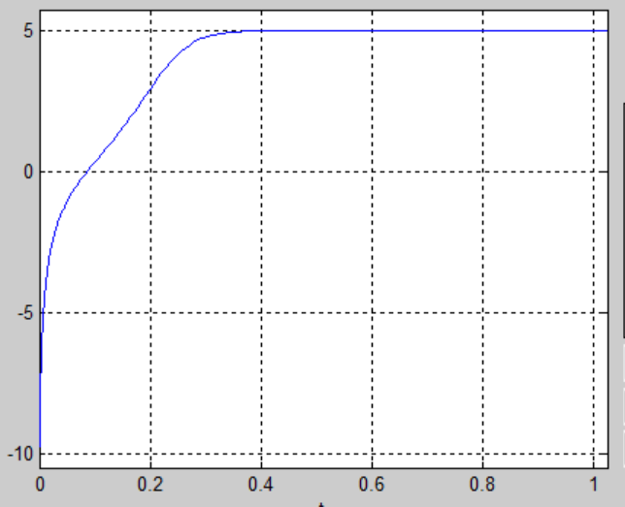
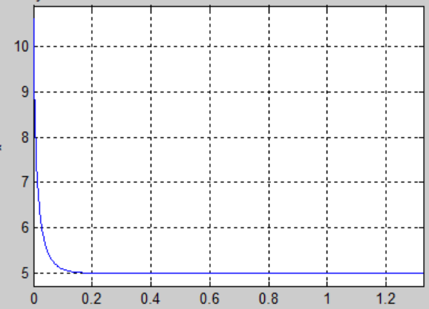
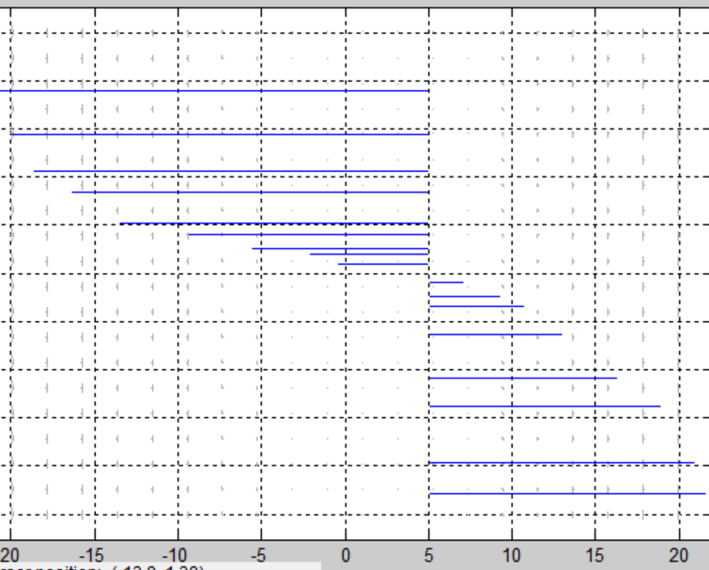
HW 7-1-1(sol)

Slide 21
HW 7-1-1(sol)
Alternate
V is PD

Slide 22
HW 7-1-2(sol)

Slide 23
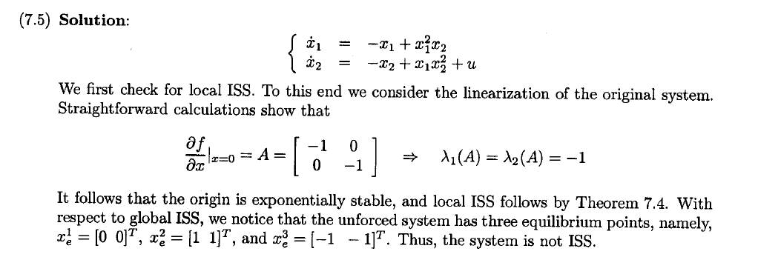
HW 7-1-2(sol)

Slide 24
HW 7-1-3(sol)

Slide 25
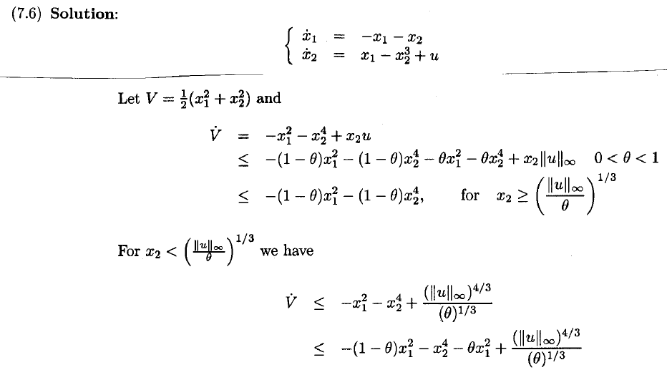
HW 7-1-3(sol)

Slide 26
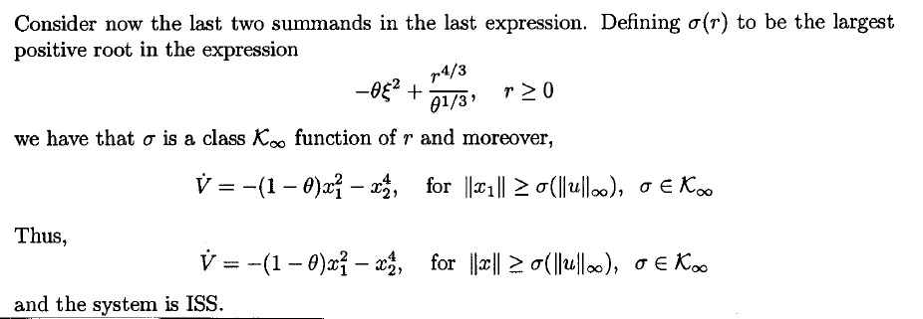
HW 7-1-3(sol)

